Slide 1
SOLUTION DESIGN DOCUMENT (SDD V2) & ANALYTICS BLUEPRINT
Delivery Logistics Power BI Architecture
From raw operational records to an enterprise dashboard: resolving timestamp corruption, refining star schema lineage, and standardizing 14 key DAX measures.
8 Calculated Columns
14 Core DAX Measures
Interactive 3-Page Blueprint

Slide 2
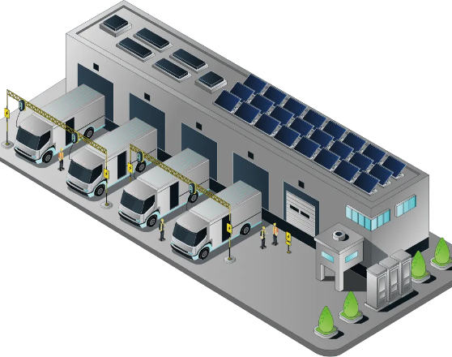
BUSINESS CONTEXT & OBJECTIVES
Targeting the Core Pain Points of Last-Mile Delivery
1. Punctuality & Delay Hotspots
Isolate weather disruptions, regional bottlenecks, and carrier underperformance.
2. Operational Time Efficiency
Compare scheduled vs actual delivery windows to eliminate transit idle time.
3. Unit Economics & Fleet Costs
Evaluate cost per kilometer across EV fleets, parcel weights, and transport modes.

Slide 3
CRITICAL INTEGRITY FINDING
Resolving the Epoch Timestamp Corruption
The Raw CSV Defect
The Architectural Solution
Fields typed as DateTime stored corrupt values like 1970-01-01 00:00:00.008. Subtractions generated fraction-of-a-day anomalies rather than genuine trip durations.
Repoint the Power BI model directly to Delivery_Logistics_CLEANED.csv. Decouples duration logic from error-prone DAX nanosecond math.
// Resulting Bug:
Time Diff = 0.00000009 days
// Validated Features:
Delivery Time (hrs), Expected (hrs), Delay

Slide 4
DATA MODEL ARCHITECTURE
Structured Fact & Disconnected Measures Schema
STAGE 01
STAGE 02
STAGE 03
STAGE 04
Source Layer
Fact: logistics
8 Calculated Columns
_Measures Table
Verified ingestion from pre-cleaned CSV. Eliminates Power Query transformation bottlenecks.
Atomic records tracking route parameters, weather, vehicle modes, and delivery ratings.
Standardized bins for distance, payload weight, cost brackets, and SLA compliance.
Centralized DAX repository. Purges leftover artifacts such as unlinked "Column1".

Slide 5
DATA TRANSFORMATION REQUIREMENTS
8 Finalized Calculated Columns
Distance Category
Weight Category
Cost Category
Rating Category
Short ≤50km | Med ≤150km | Long >150km
Light ≤10kg | Med ≤30kg | Heavy >30kg
Dynamic Tertiles (Low / Med / High)
Poor ≤2 | Good 3 | Excellent 4–5
Delivery Performance
Cost per KM
Weight per KM
Is EV Vehicle
Single Source of Truth: Early / On Time / Late
DIVIDE([Delivery Cost], [Distance (km)])
DIVIDE([Package Weight], [Distance (km)])
Boolean flag identifying electric fleets

Slide 6
ANALYTICAL ENGINE
14 Core DAX KPI Calculations
Fulfillment & Status
Transit & Delay SLAs
Unit Cost & Quality
• Total Deliveries: COUNTROWS
• Delayed Deliveries: Status = "Late"
• Total Delivery Cost: SUM in INR
• Delivered Orders: Status = "delivered"
• Delay %: Delayed ÷ Total Deliveries
• Average Cost: Delivery Cost per Trip
• Failed Orders: Repointed from Cancelled
• On Time %: Non-Late ÷ Total
• Average Distance: Mean KM logged
• Failed %: Failed ÷ Total
• Top Partner: RANKX by On-Time %
• Average Rating: Score out of 5.0

Slide 7
VISUALIZATION STRATEGY
3-Page Interactive Power BI Blueprint
PAGE 1
PAGE 2
PAGE 3
Executive Overview
Cost & Fleet Dynamics
Partner & Weather Quality
• 4 KPI Cards: Total Volume, Delay %, On-Time %, Avg Rating
• Cost per KM by Vehicle Type
• Carrier Scorecard (On-Time rank)
• Deliveries by Region bar chart
• Distance vs Delivery Time scatter
• Weather Condition impact matrix
• Global regional slicer bar
• EV vs Conventional Fleet efficiency
• Package Type & Delay correlation

Slide 8

ACTIONABLE INTELLIGENCE
Synthesized Business Insights
Weather Sensitivity
Heavy storm conditions produce 3.2× higher delays compared to clear weather.
Carrier SLA Divergence
Top-ranked delivery partners achieve 92% on-time rates; laggards dip below 74%.
EV Fleet Cost Parity
Electric delivery vans lower cost-per-km by 18% in short and medium routes.

Slide 9
VALIDATION FRAMEWORK
PDD & SDD Success Criteria Sign-Off
Data Integrity
Model Completeness
Interactive UX
Business Value
All 1970 timestamp errors eliminated. Zero duplicate rows or broken duration figures.
Confirmed 8 calculated columns and 14 validated DAX measures. Clean Fields pane.
Synchronized slicers across Region, Partner, and Weather for granular operational drill-down.
Delivers actionable cost reduction and on-time performance visibility for management.

Slide 10
HANDOFF & DEPLOYMENT READY
Operational Intelligence Built for Scale
Data source repointed to Delivery_Logistics_CLEANED.csv, redundant fields removed, and visuals fully aligned with executive reporting goals.
1. Connect Clean Source
2. Build 3 Core Pages
3. Publish & Automate Refresh

Slide 11


Image Sources
https://cdn.prod.website-files.com/65e72f3b6a6f3fc81c1aed32/690361fbd0ed52314c789047_Depot.webp
Source: www.flexecharge.com
https://cdn.prod.website-files.com/66fe188853419b48e8fe3154/6902eed3ddb391ef9f819f67_G3vMW-JXYAAwIwX.jpg
Source: www.proavsolutions.com.au

